Slide 1
ARGroup
Mahzabin Hasnath
Kathleen Lee
Taewan Shim

Slide 2
Project Idea
We collaborated with Samantha Siu of the CGUI lab in the development and testing of her Making & Knowing application. The areas of help she requested was in testing of her application and designing of a test database in which the entire process of following a recipe and user’s annotation at each step is readily available.

Slide 3
Database Architecture

Slide 4



Technologies
Google Cloud
MySQL
Unity

Slide 5
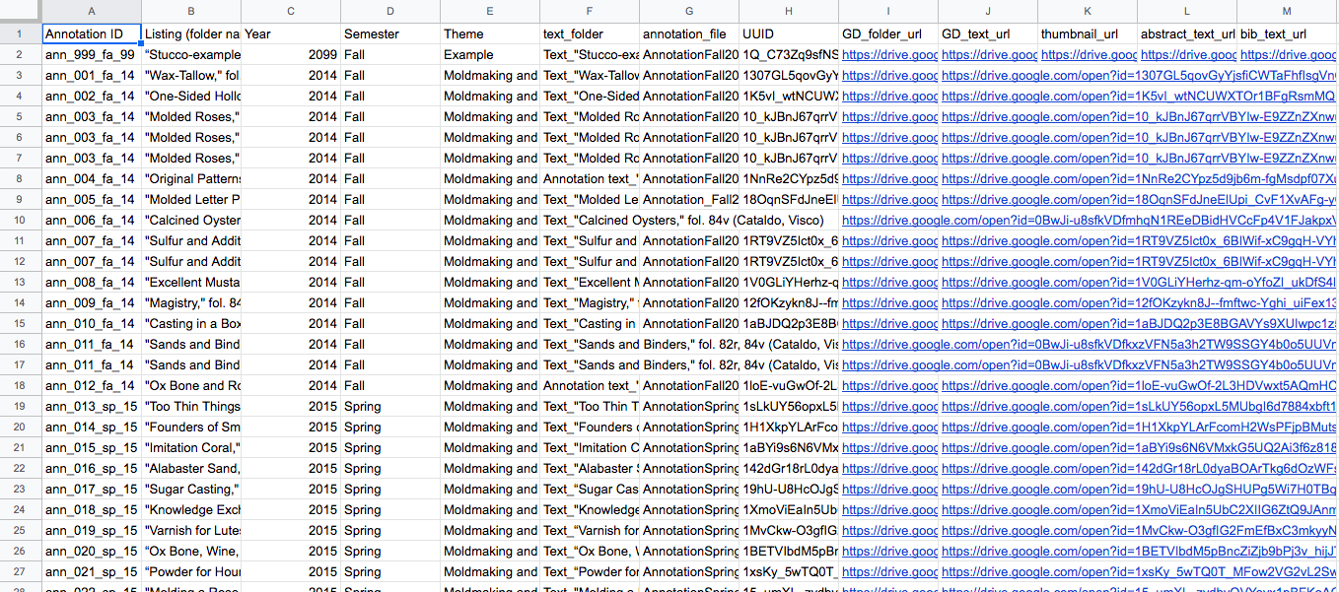
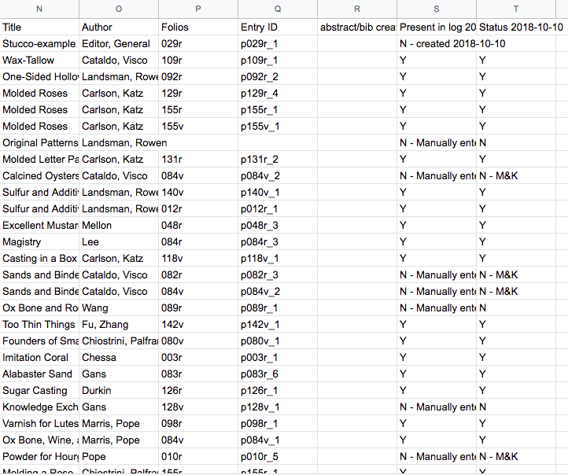
Preprocessing annotation-metadata.csv
Notes:
We cleaned up the data. Talk about why we needed to do that (folio column)

Slide 6
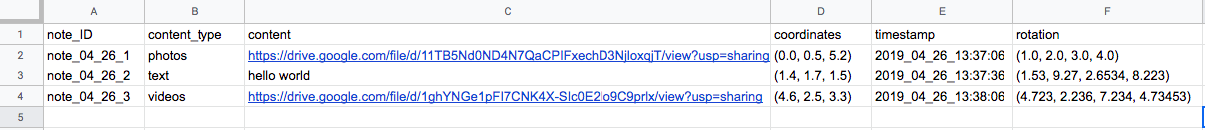
Construction of notes.csv
Notes:
Construction of notes table for Sam’s app. Need somewhere to store the app data. Need to write data to this table. Added dummy data

Slide 7
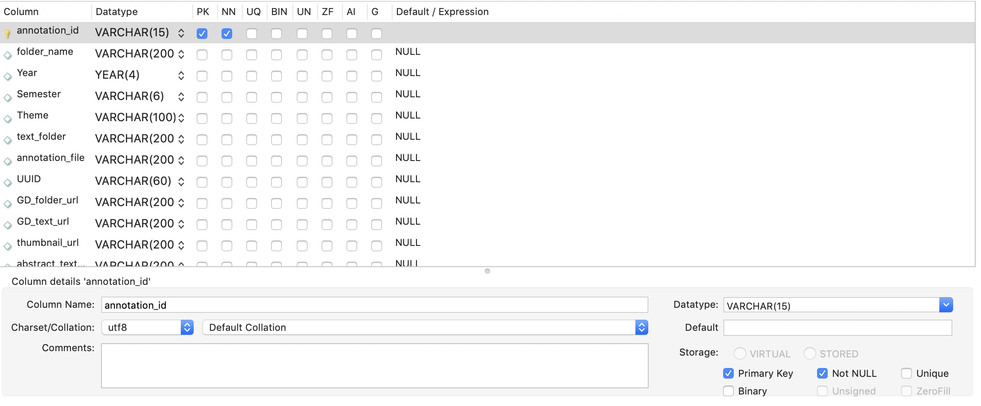
Building the Tables
Converted annotation-metadata.csv and notes.csv into SQL tables

Slide 8
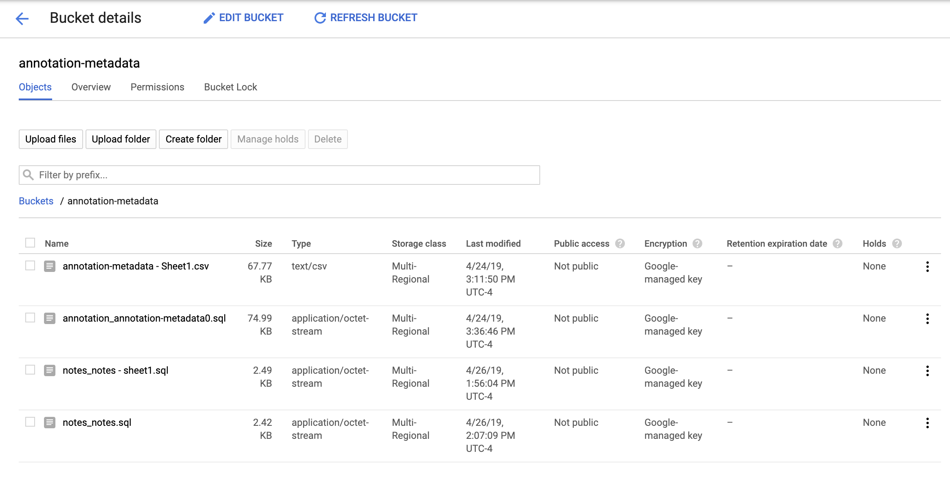
Building the Tables
Uploaded each table to the database

Slide 9
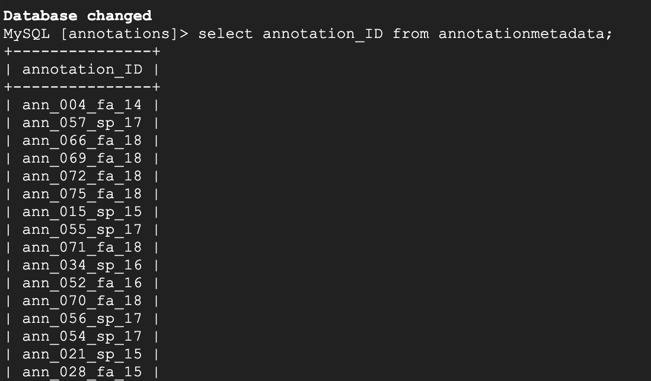
Building the Tables
Tested if we can retrieve data from annotation-metadata table

Slide 10
Building the Tables
Tested if we can retrieve data from and write data to notes table

Slide 11
Testing in Unity

Slide 12
User Testing

Slide 13
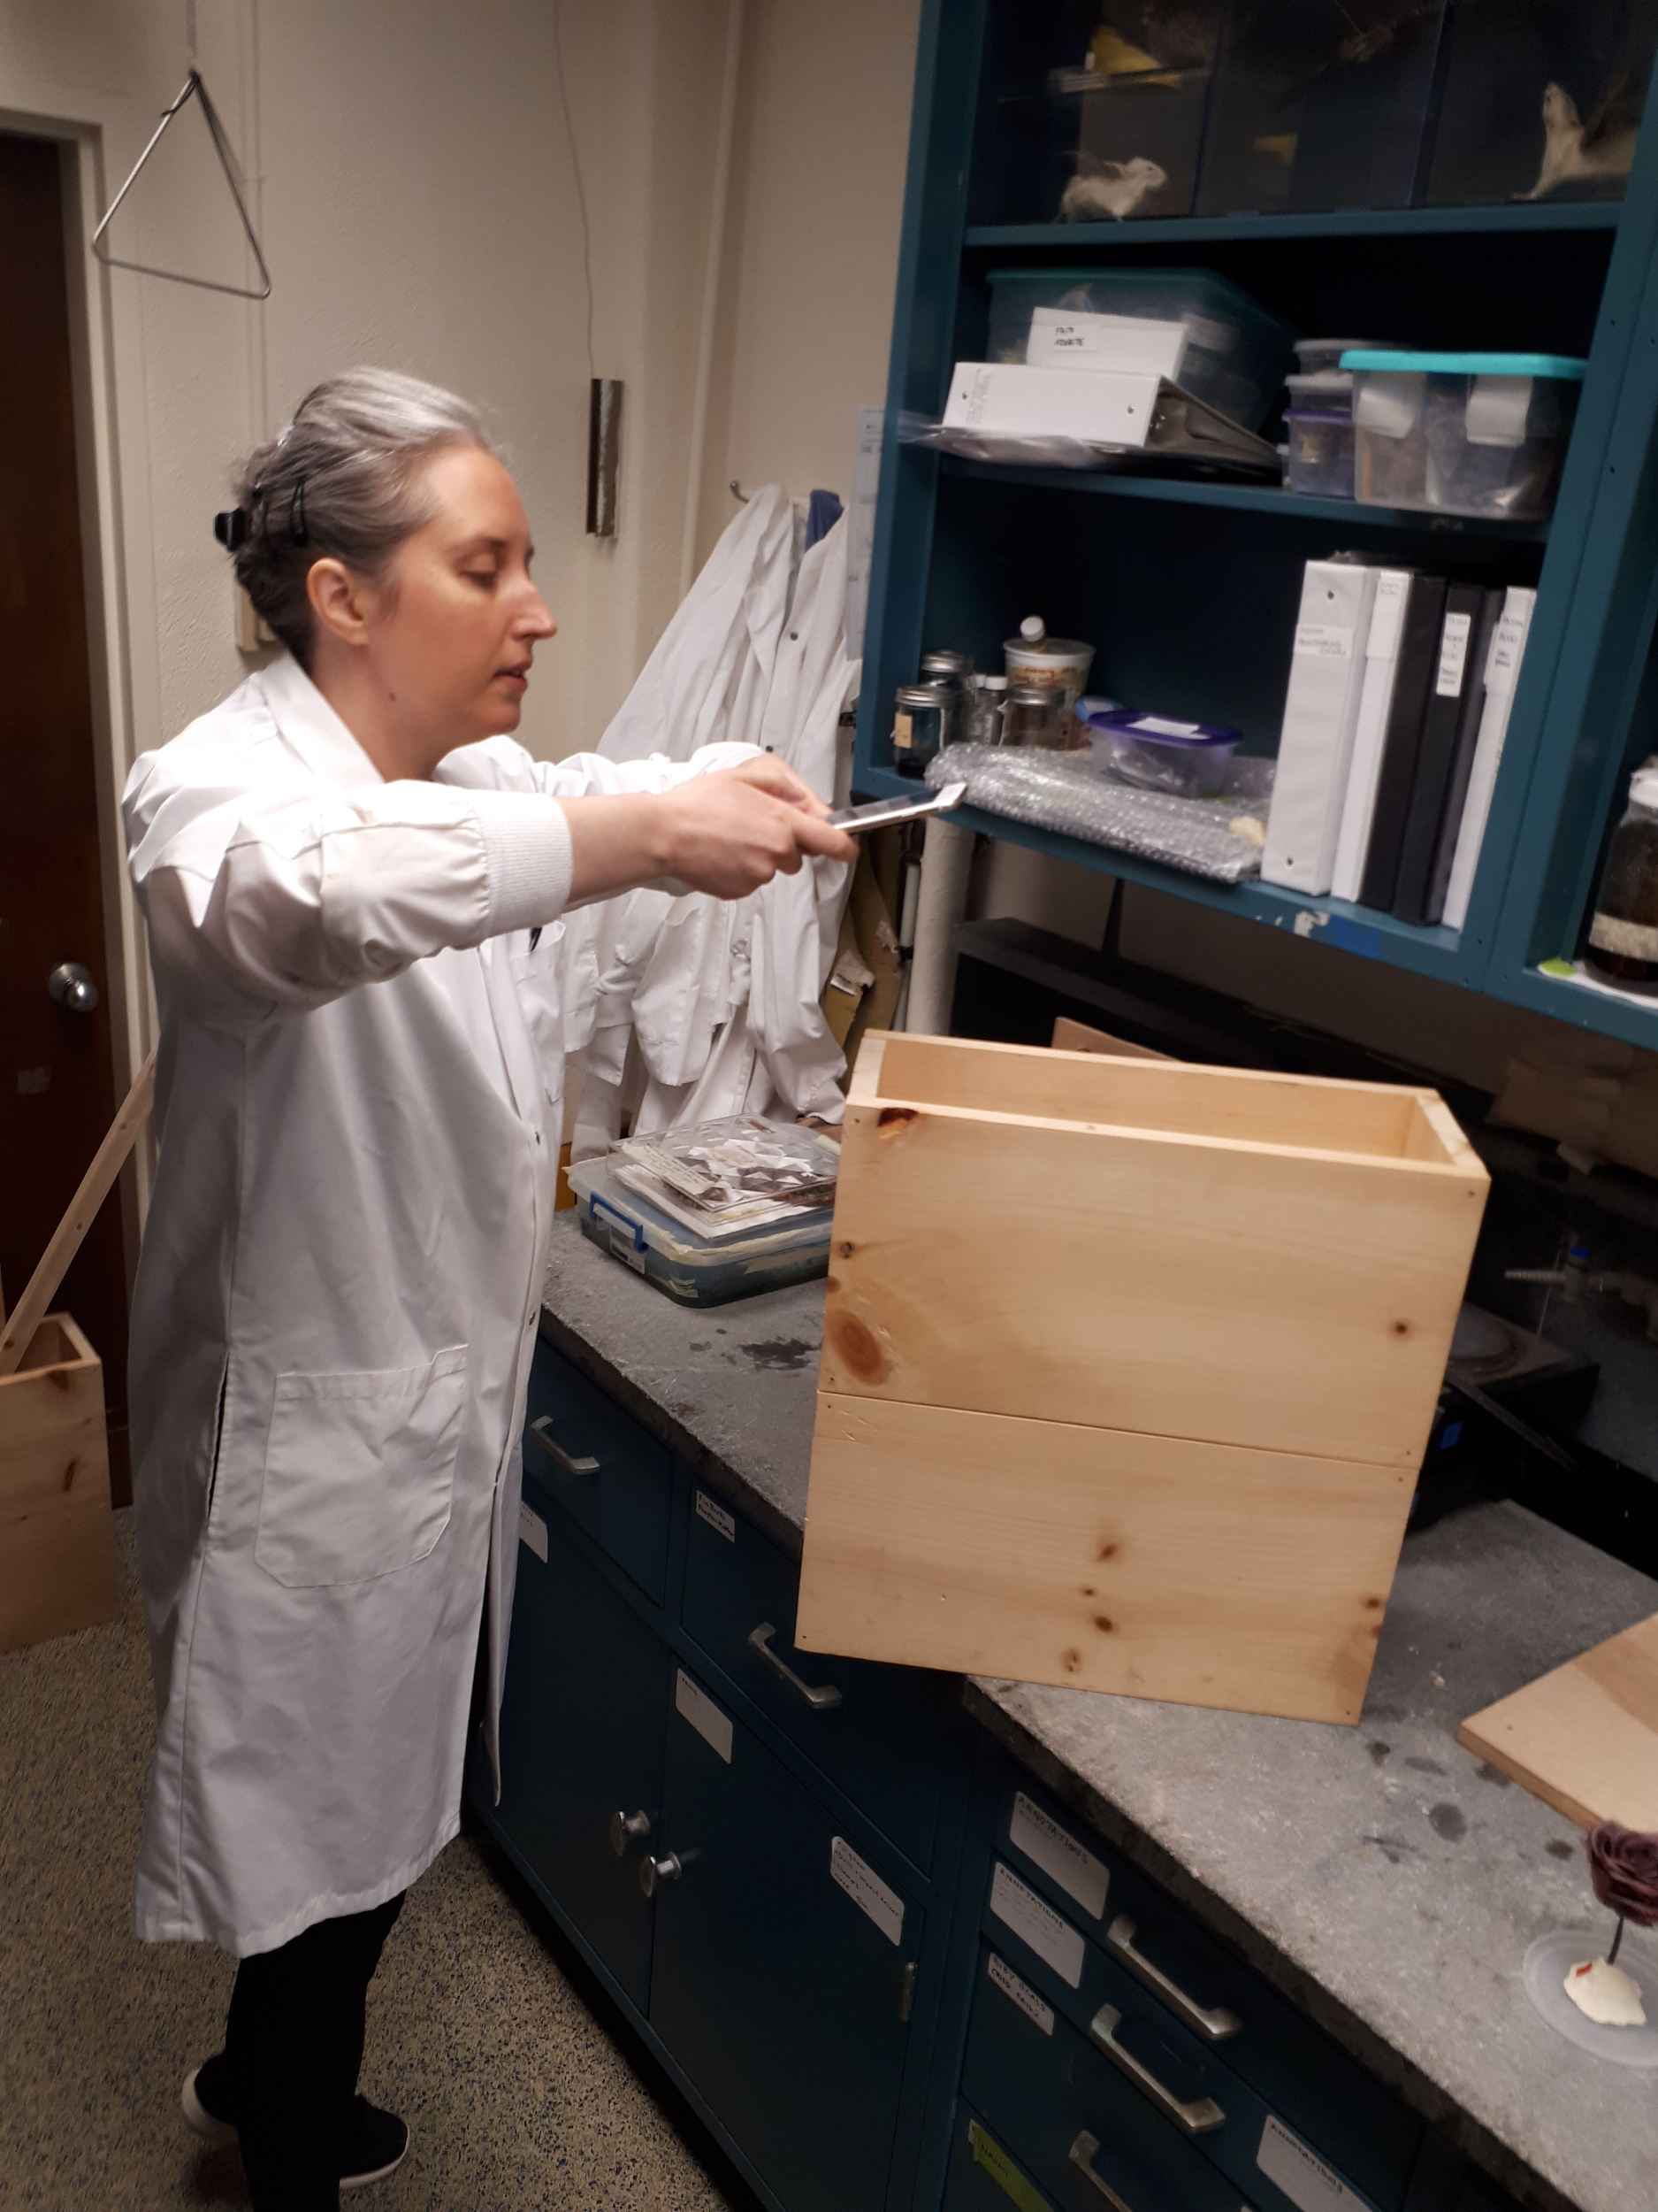
Persona 1: Tianna (Researcher in the M&K Lab)
Reconstruct a dry flower following the steps indicated on folios 120v-121r in Ms. Fr. 640.
  Take photos
  Write annotations
    Create a replicable process

Slide 14
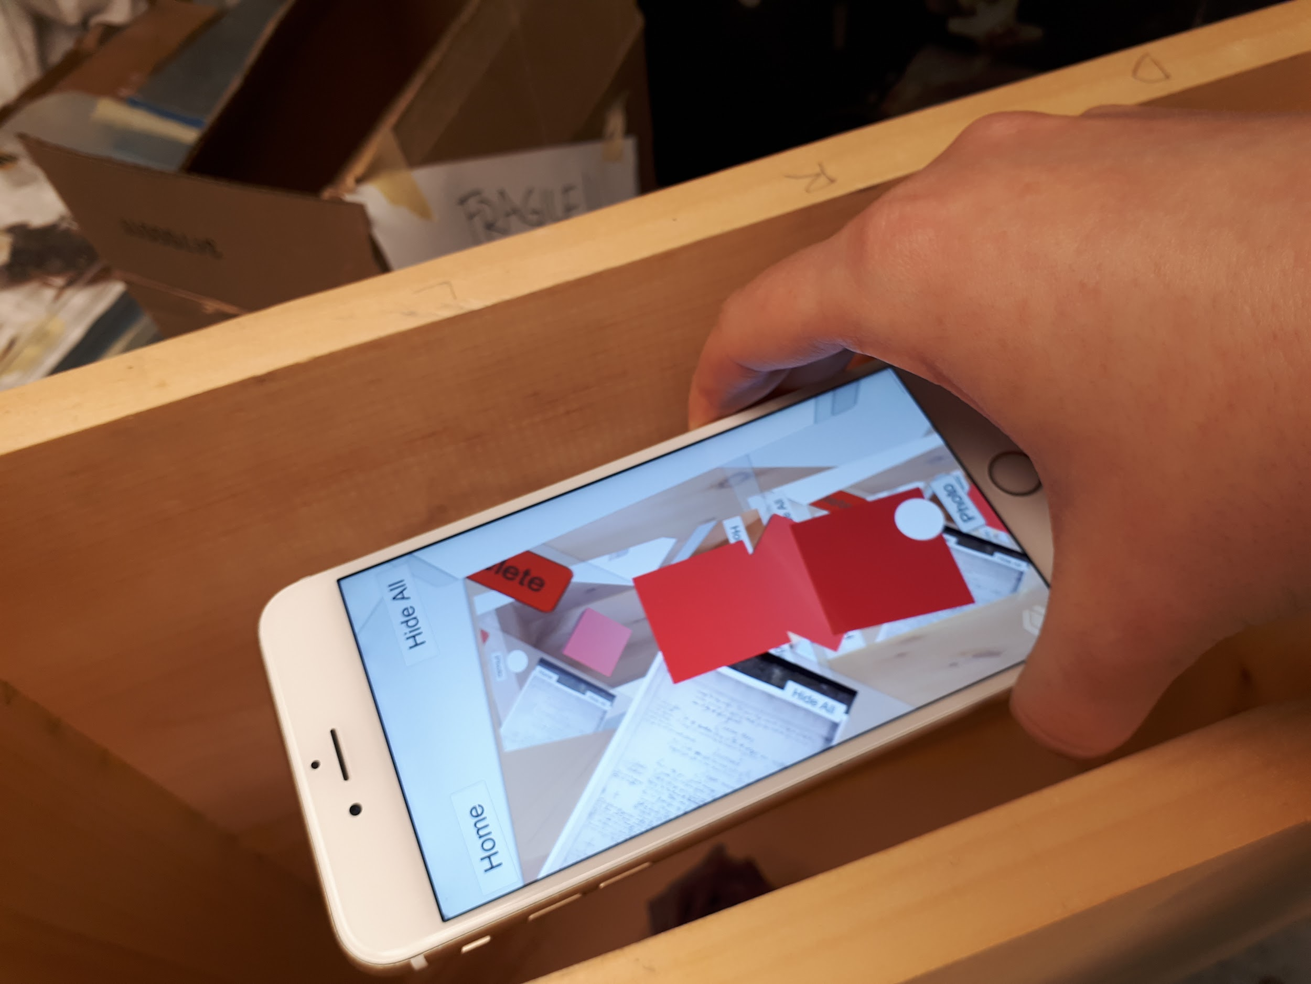
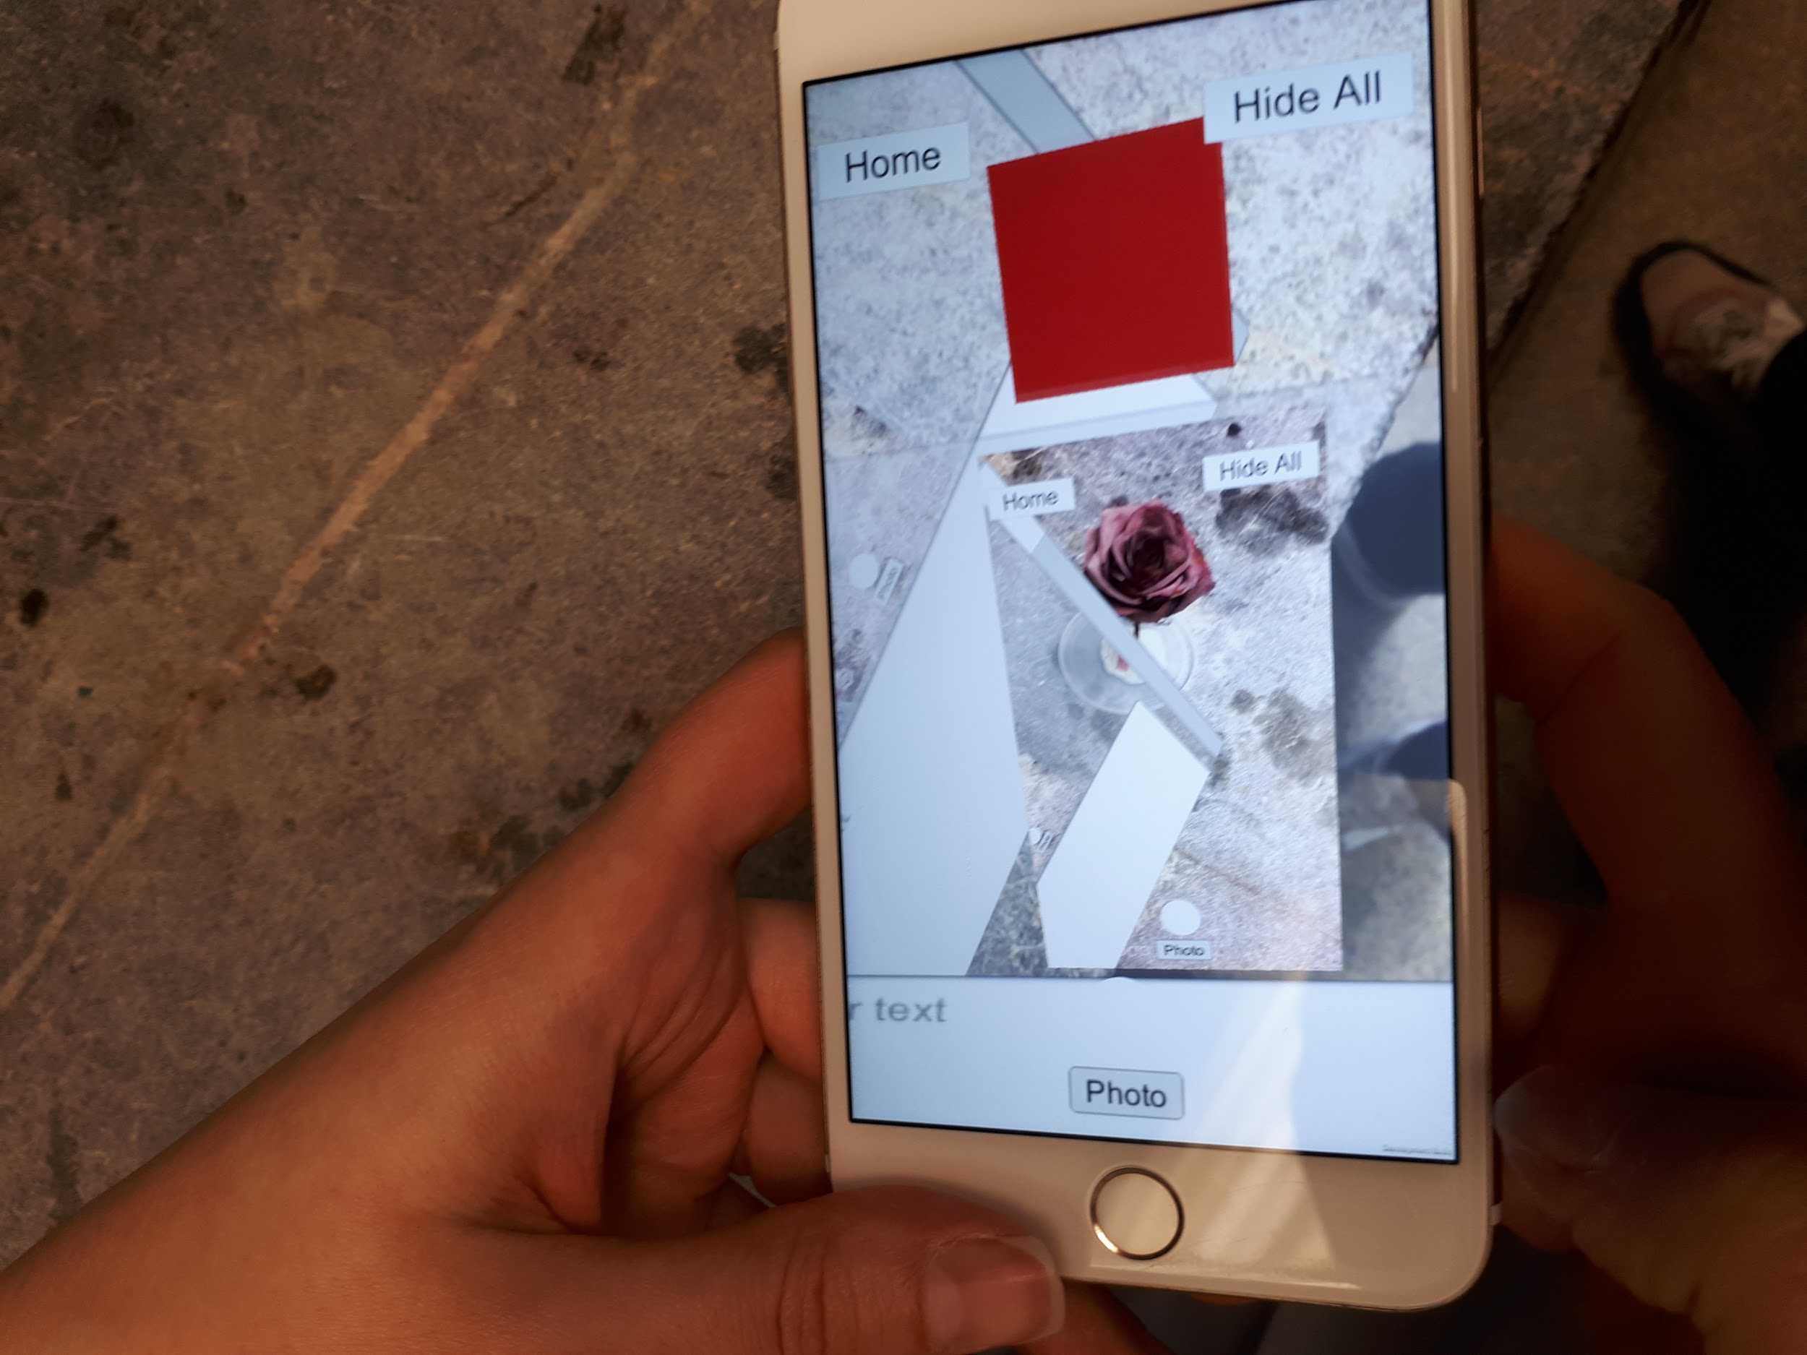
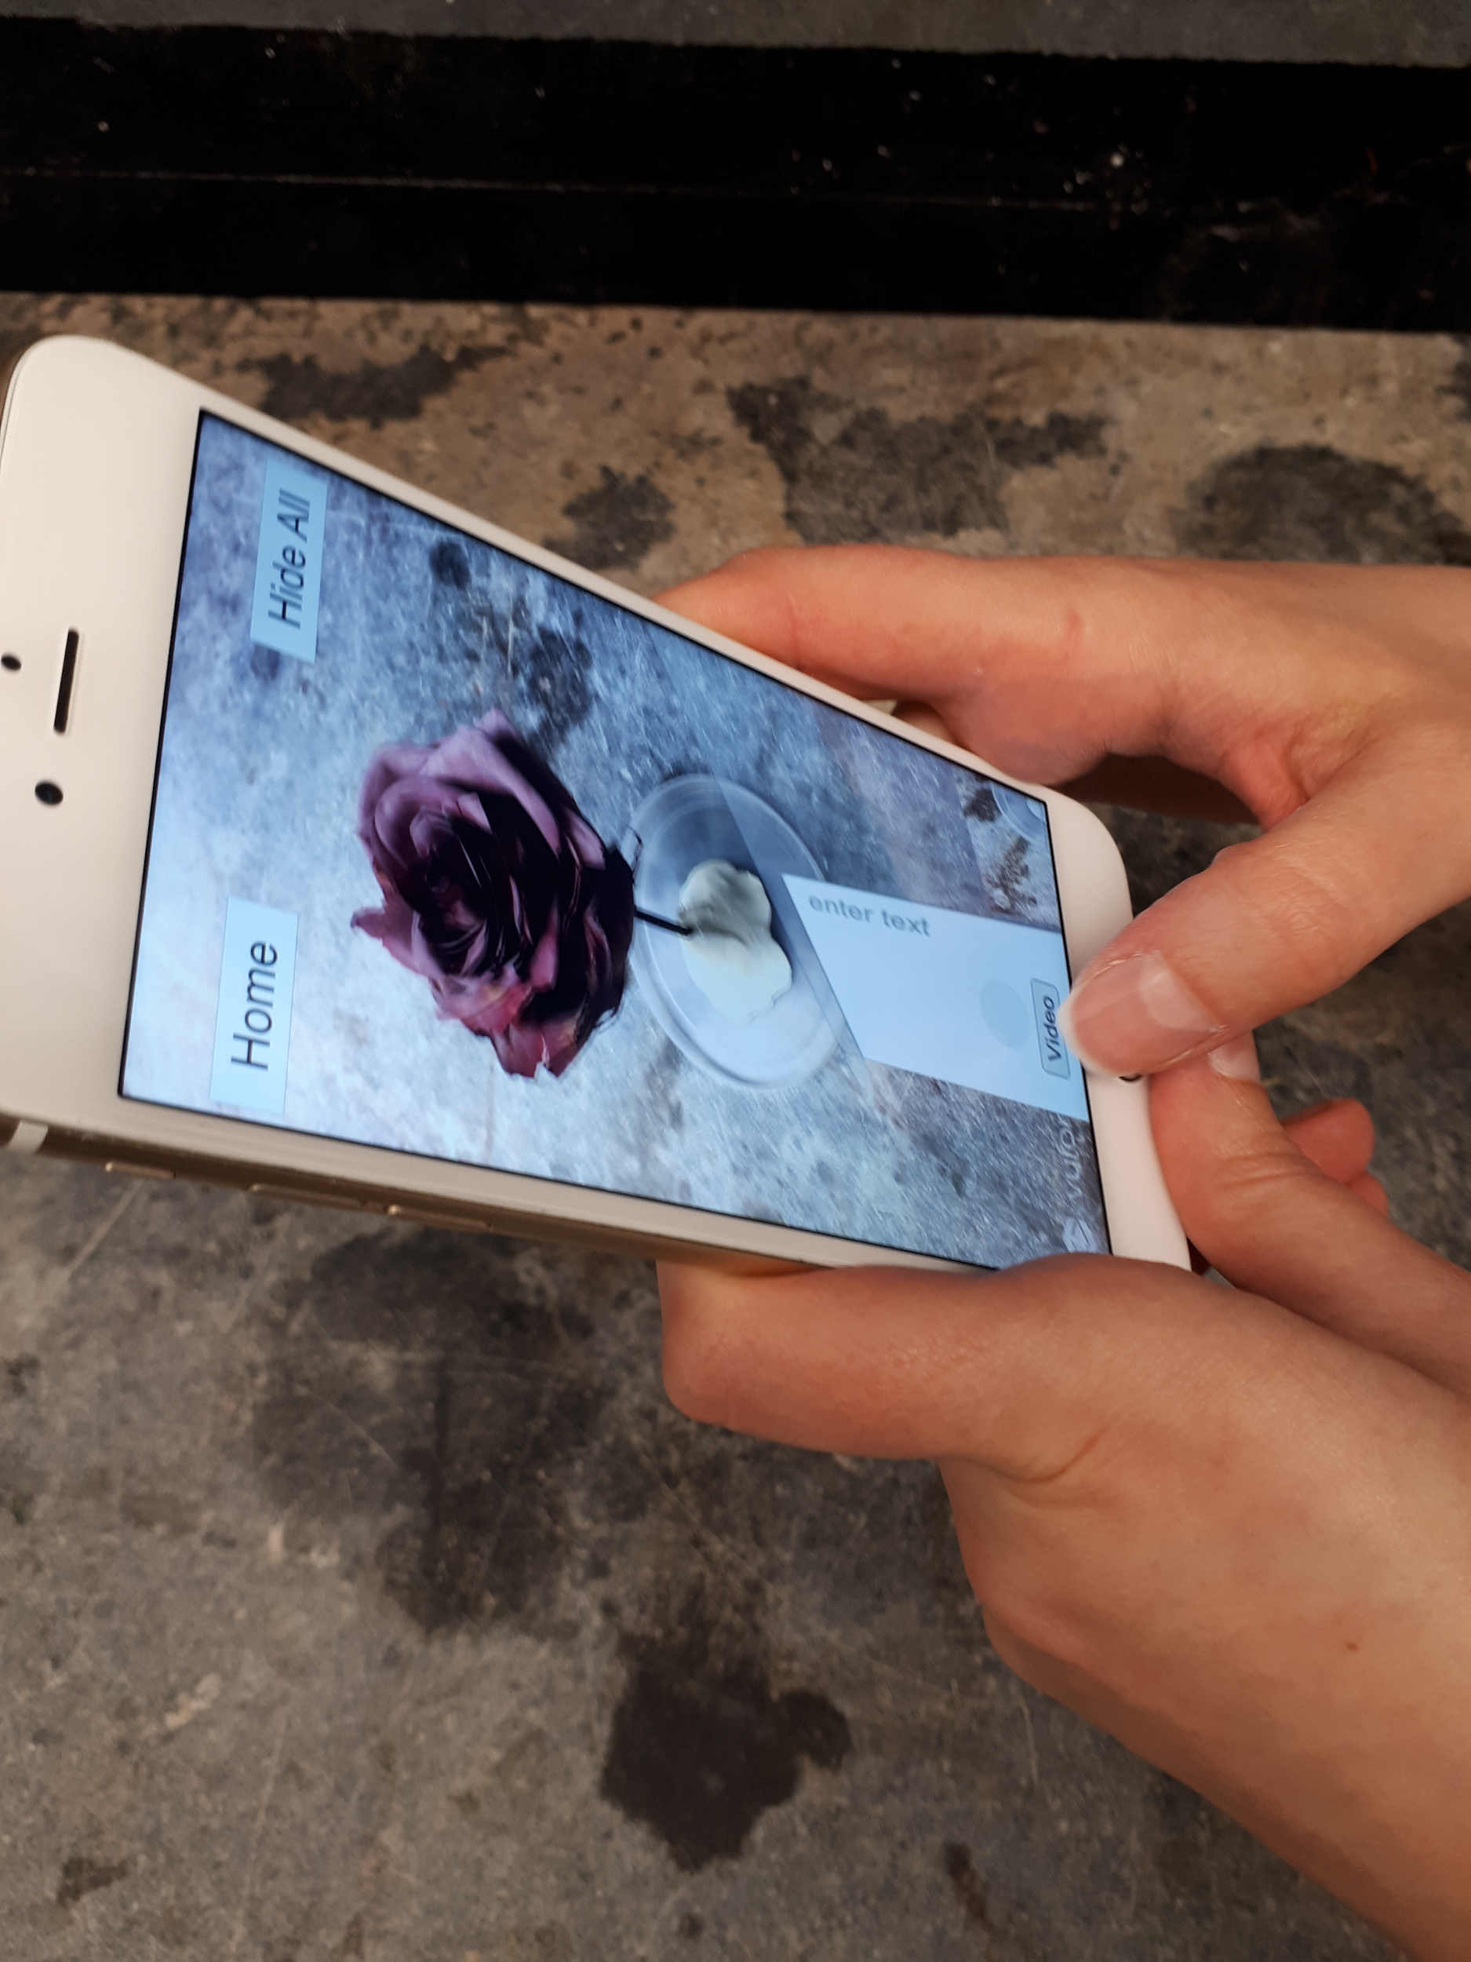
Problems & Solutions for Persona 1
Figure 1
Figure 2
Figure 3

Slide 15
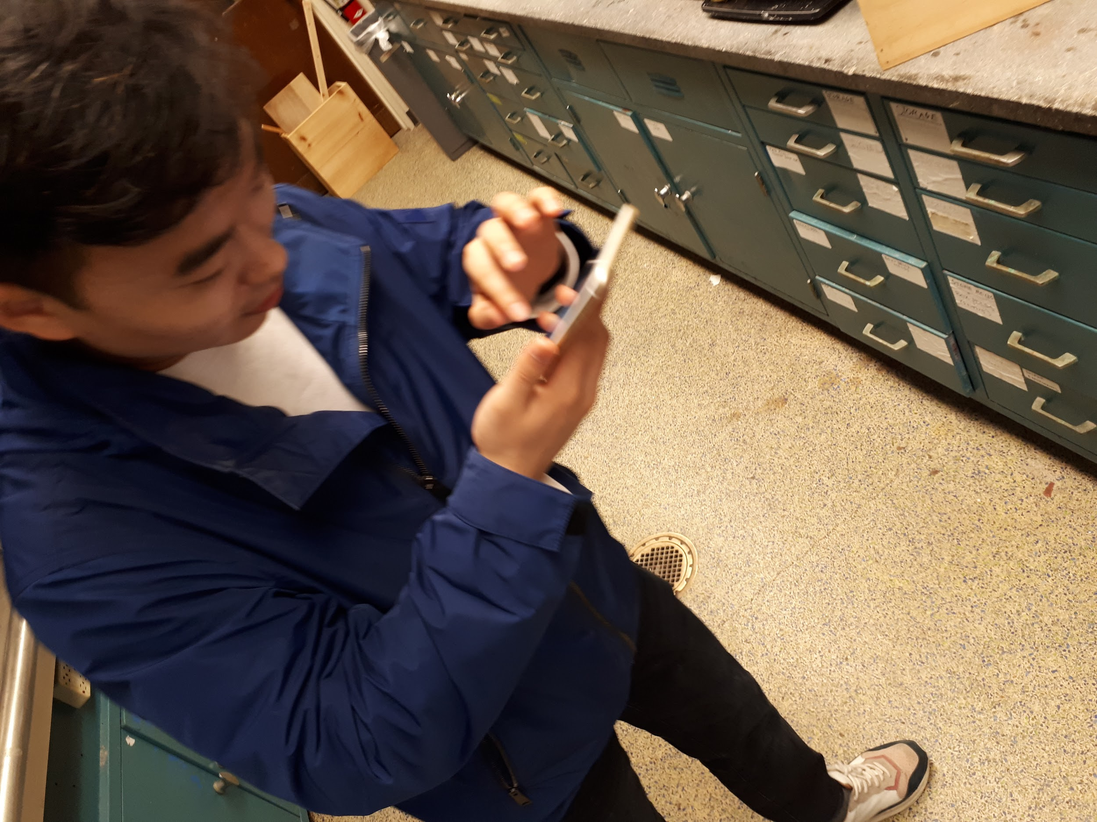
Persona 2: Taewan (Student in the M&K Lab)
Understand and ultimately replicate the process previously done by Tianna
  Red boxes (photos and annotations) are scattered all over the space
  Move around to find each and every red box

Slide 16
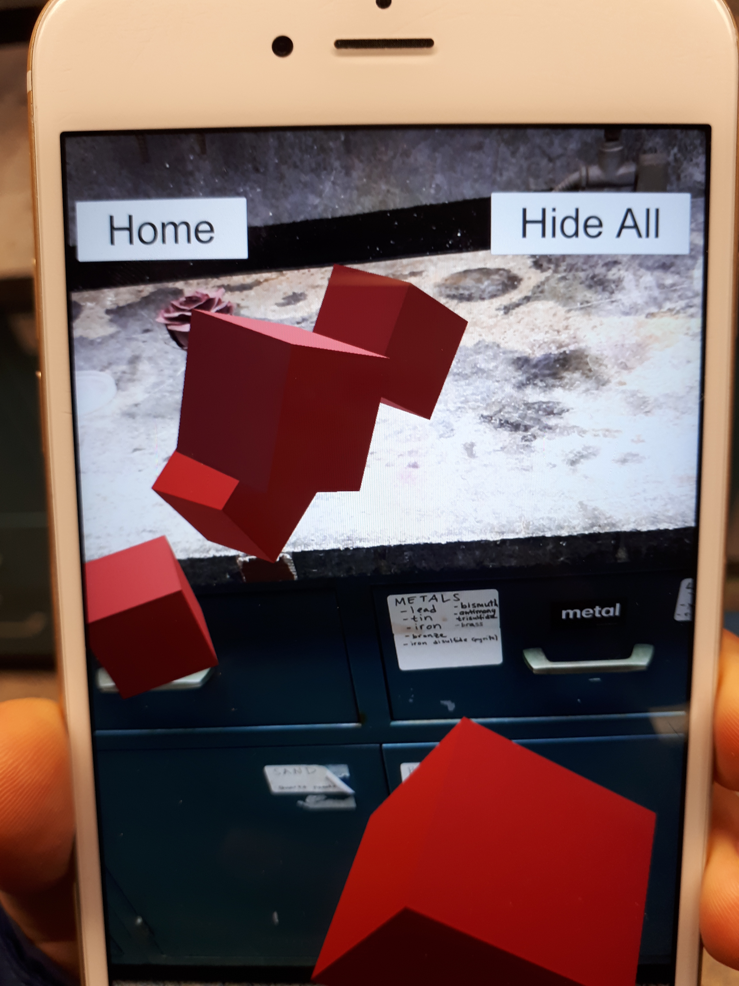
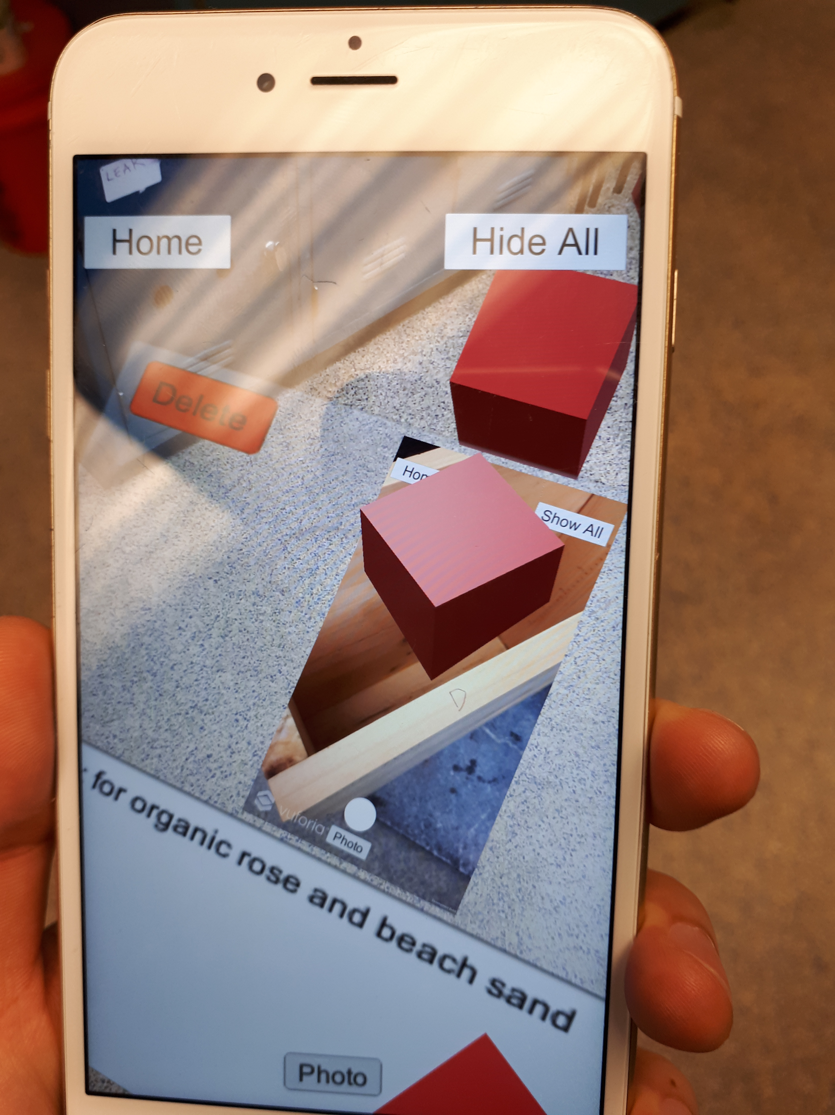
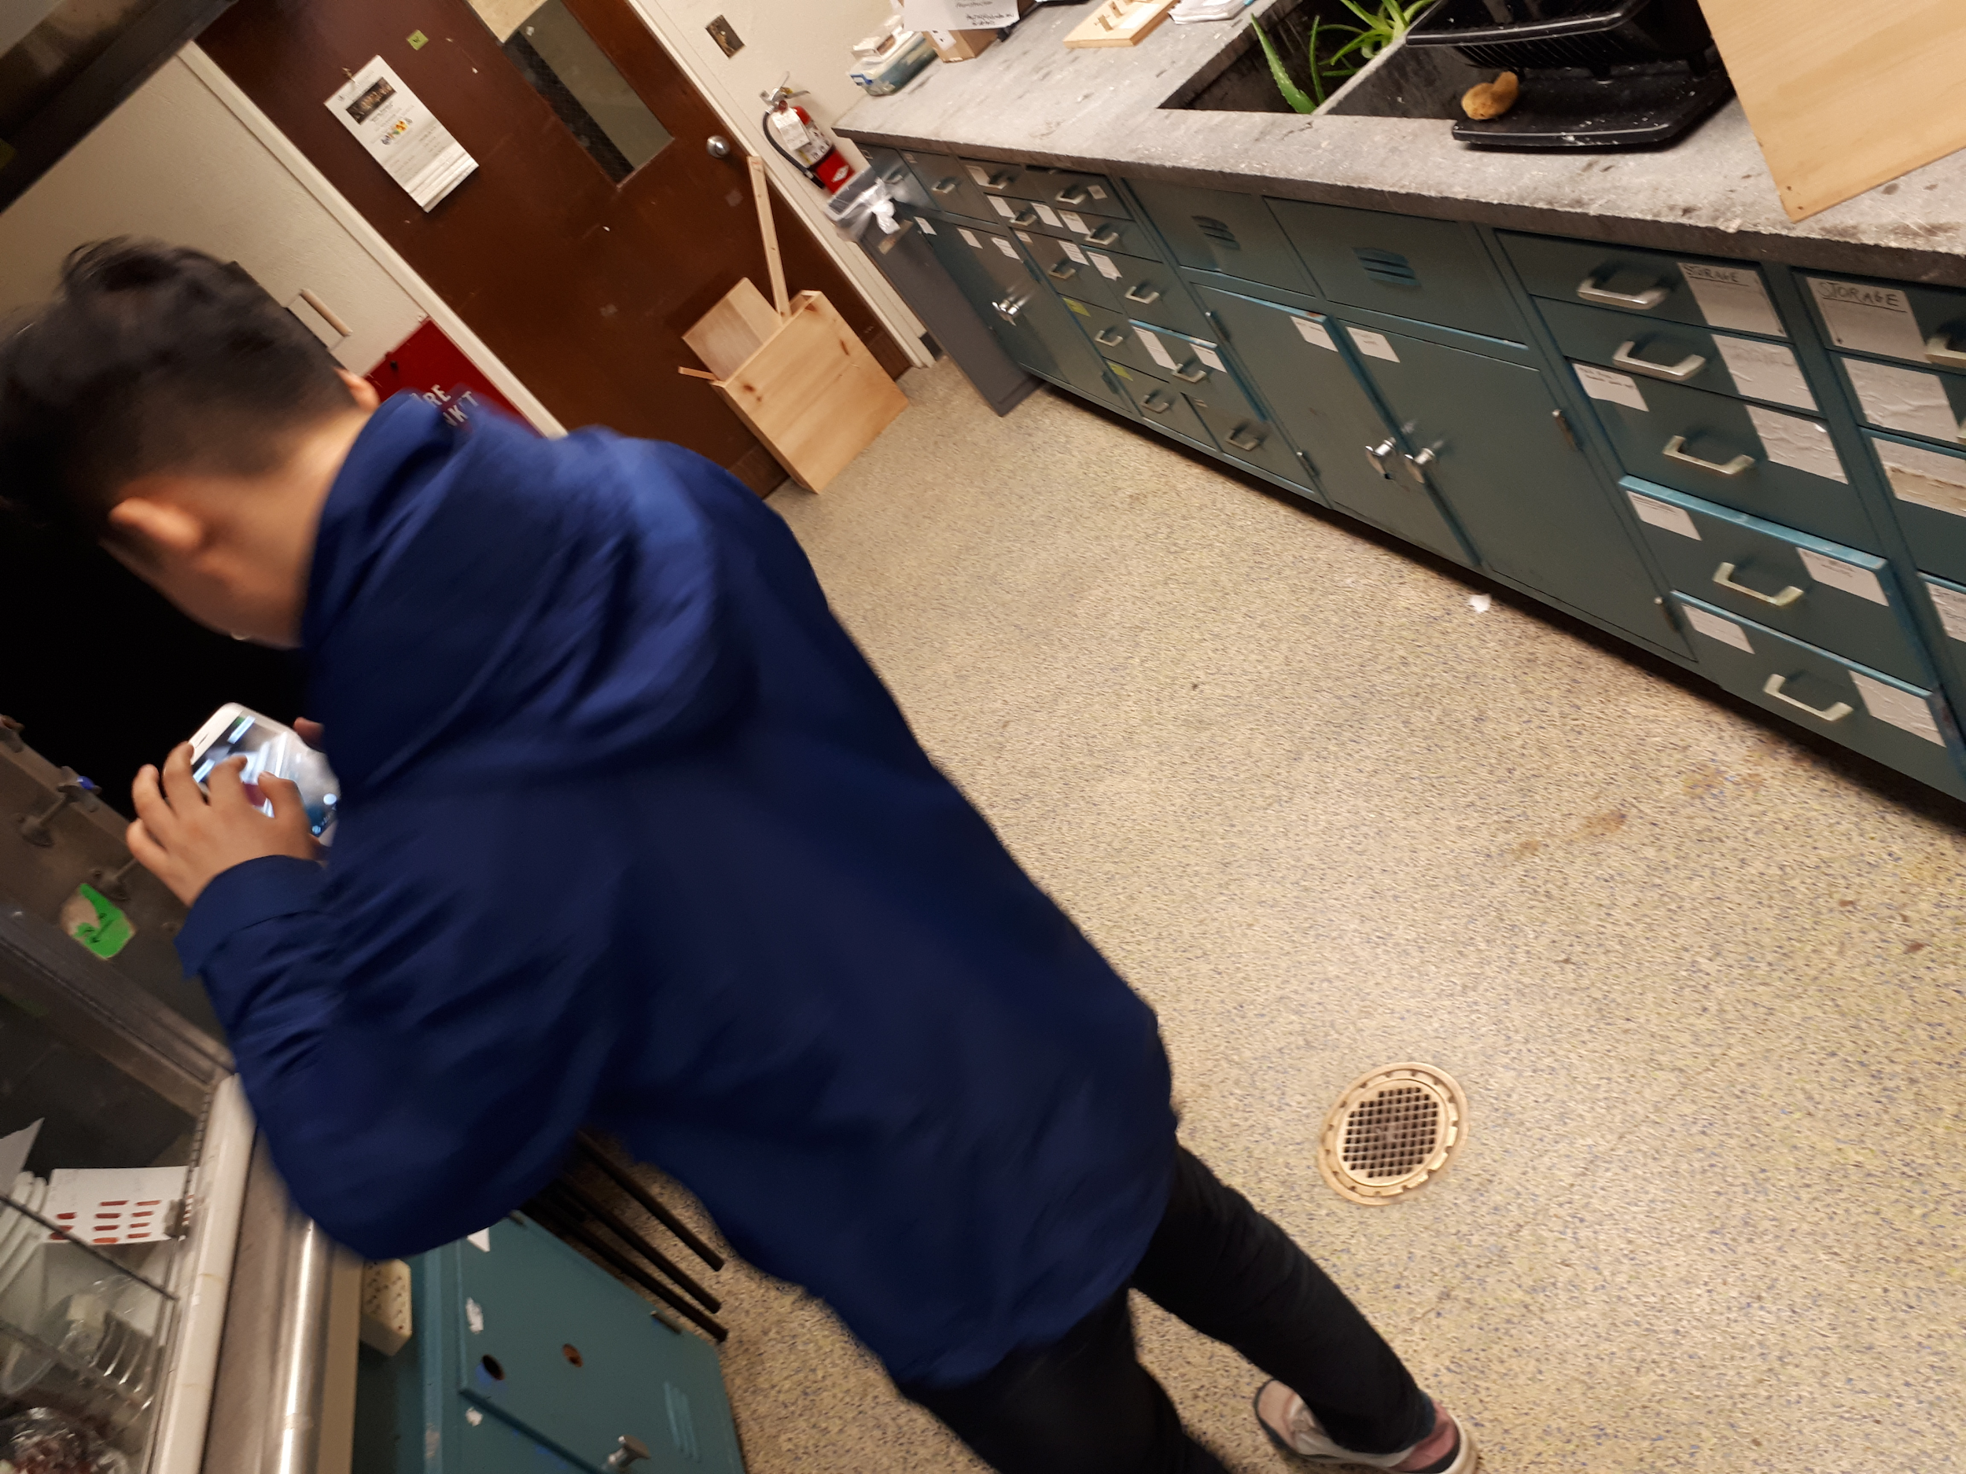
Problems & Solutions for Persona 2
Figure 6
Figure 4
Figure 5

Slide 17
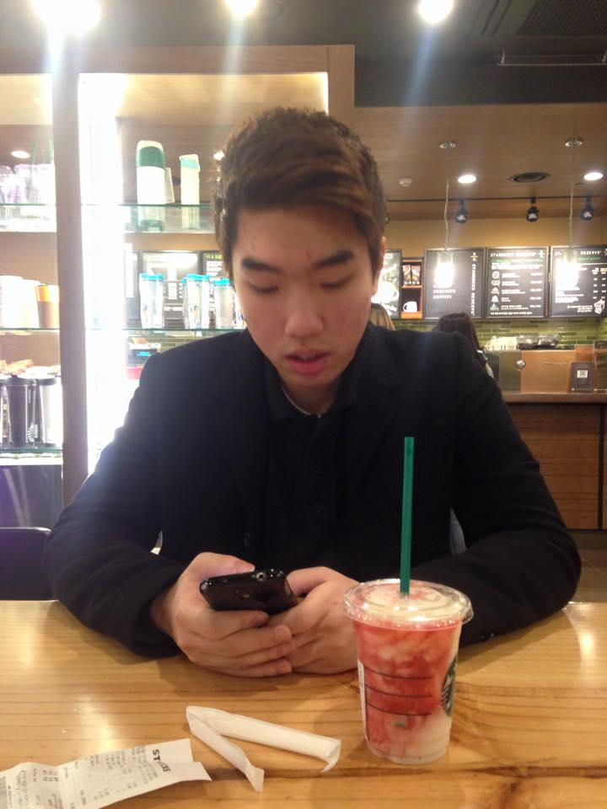
Persona 3: Mark (Reader of Ms. Fr. 640 not in NYC)
Due to the lack of proximity from the M&K Lab, Mark wishes to learn more about and virtually experience the process of drying a flower (folios 120v-121r) by using Sam’s application downloaded on his iPhone
  Use database and cloud directly linked to the app
  Follow instructions laid out by Tianna

Slide 18
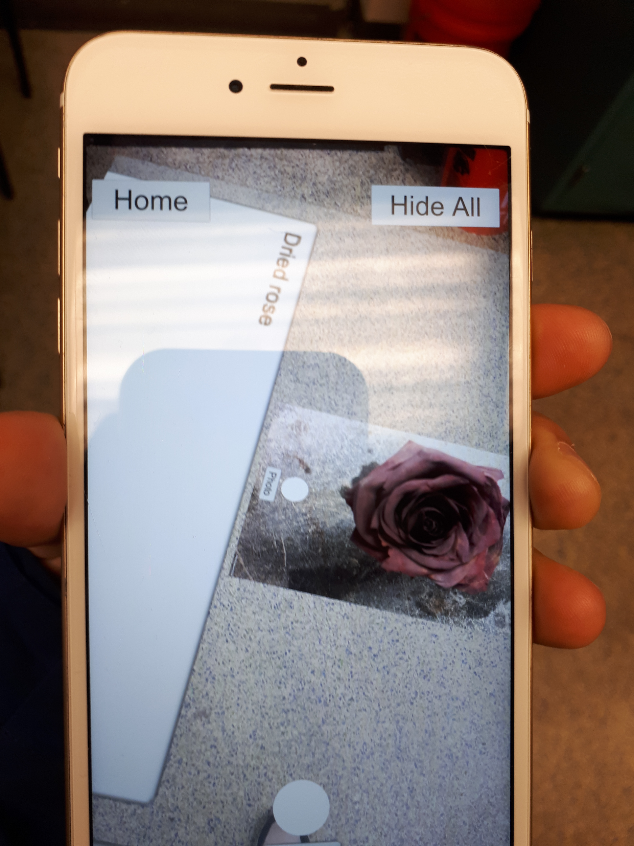
Problems & Solutions for Persona 3
***Cloud and database storage is not an available function yet
  Multiple potential bugs related to connection with the database
Similar problems founded by Persona 2
  Not a reader-mode text box
  Difficult positioning
  Zoom-in and zoom-out function needed
Figure 7

Slide 19
Thank You!

